Slide 1
Cubic Spline Discount Function

Slide 2
Objective: To extract a smoothed yield curve from a set of Treasury security data
Standard approach:
Step 1: Regress the discount function on a spline
Step 2: Convert the discount function into a yield curve

Slide 3
Step 1: Regress the discount function on a spline
If R(0 , t) is the yield curve then the discount function P(0 , t) = Exp (- R(0 , t) *t)
Given data on N bonds, use n-1 piecewise polynomials to approximate P(0 , t)

Slide 4

$$P\left(0,t\right)= \left\{{{{β_{1,0}+ β_{1,1}t+ β_{1,2}t^{2}+ β_{1,3}t^{3}, t ε \left[t_{1}, t_{2}\right] \atop β_{2,0}+ β_{2,1}t+ β_{2,2}t^{2}+ β_{2,3}t^{3}, t ε \left[t_{2}, t_{3}\right]} \atop {: \atop :}} \atop {{β_{i,0}+ β_{i,1}t+ β_{i,2}t^{2}+ β_{i,3}t^{3}, t ε \left[t_{i}, t_{i+1}\right] \atop :} \atop {: \atop β_{n,0}+ β_{n,1}t+ β_{n,2}t^{2}+ β_{n,3}t^{3}, t>t_{n}}}}\right.$$

Slide 5
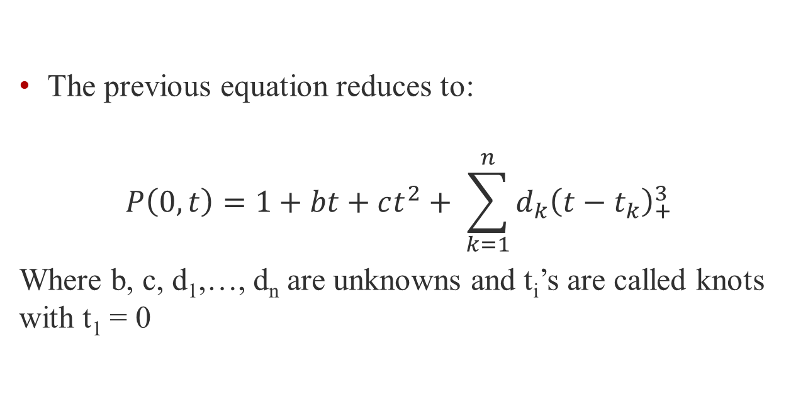
Spline Equation
The previous equation reduces to:
$$P\left(0,t\right)=1+bt+ct^{2}+ \sum_{k=1}^{n}{d_{k}{\left(t−t_{k}\right)}_{+}^{3}}$$
Where b, c, d₁,…, d_{n} are unknowns and t_{i}’s are called knots with t₁ = 0

Slide 6
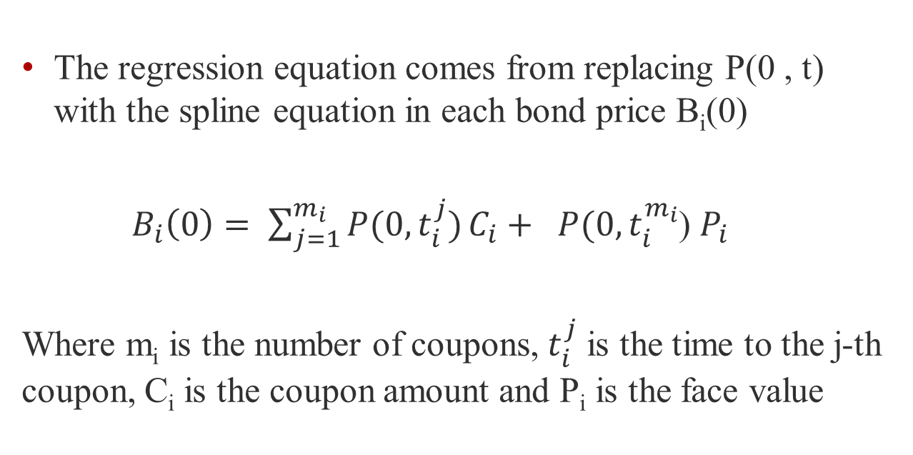
Bond Price Equation
The regression equation comes from replacing P(0 , t) with the spline equation in each bond price B_{i}(0)
${ B}_{i}\left(0\right)= \sum_{j=1}^{m_{i}}{P(0,t_{i}^{j})}C_{i}+ P(0,t_{i}^{m_{i}}$) $P_{i}$
Where m_{i} is the number of coupons, $t_{i}^{j}$ is the time to the j-th coupon, C_{i} is the coupon amount and P_{i} is the face value

Slide 7

Define
$$y_{i}≜ B_{i} − C_{i}m_{i} − P_{i}$$
$$x_{i,1} ≜ C_{i}\sum_{j=1}^{m_{i}}{t_{i}^{j}+ P_{i}t_{i}^{m_{i}}}$$
$$x_{i,2} ≜ C_{i}\sum_{j=1}^{m_{i}}{{(t}_{i}^{j})^{2}+ P_{i}{(t}_{i}^{m_{i}})^{2}}$$
$$x_{i,k+2} ≜ C_{i}\sum_{j=1}^{m_{i}}{{(t}_{i}^{j}−t_{k})_{+}^{3}+ P_{i}{(t}_{i}^{m_{i}}−t_{k})_{+}^{3}}$$
for k=1…n

Slide 8
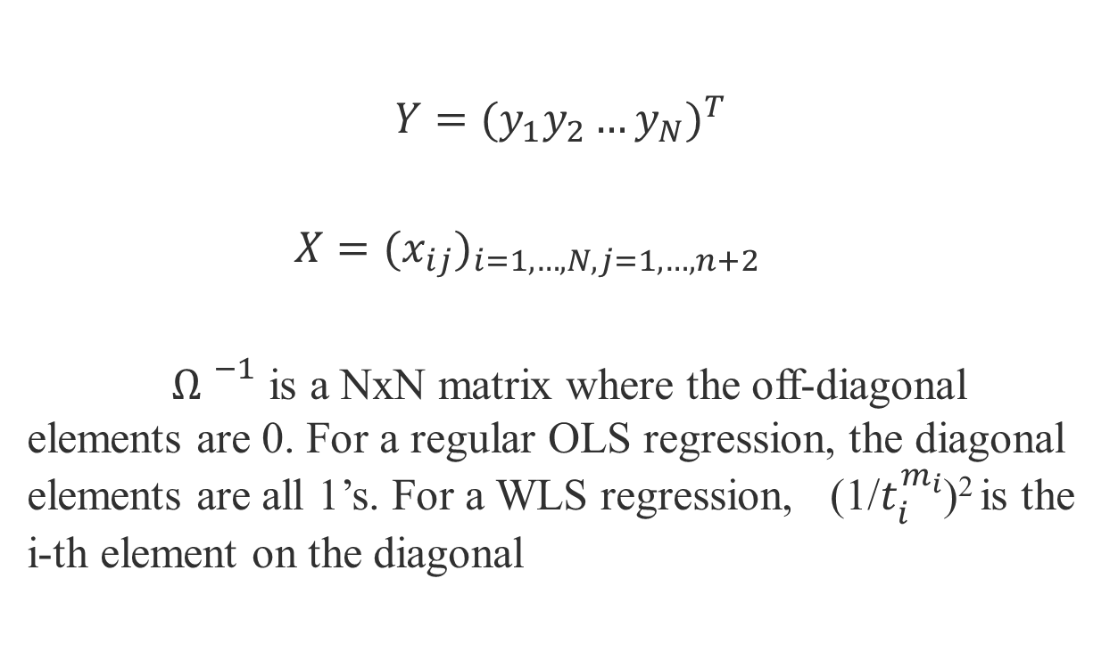
Regression Formulation
$$Y=(y_{1}y_{2}…y_{N})^{T}$$
$X=(x_{ij})_{i=1,…,N, j=1,…,n+2}$
${Ω }^{−1}$ is a NxN matrix where the off-diagonal elements are 0. For a regular OLS regression, the diagonal elements are all 1’s. For a WLS regression, (1/$t_{i}^{m_{i}}$)² is the i-th element on the diagonal

Slide 9

Regression Estimation
$β=(X^{T}$ ${Ω }^{−1} X)^{−1} X^{T}$ ${Ω }^{−1} Y$
Where ẞ = (b c d₁…d_{n})^{T}

Slide 10
Step 2: Convert the discount function into a yield curve
Given ẞ, evaluate the spline equation
Convert the discount function into a yield curve by using R(0 , t) = - ln[P(0 , t)] / t

Slide 11
Assignment
Write a macro that:
Takes Treasury bond descriptions as inputs, including next-payment time, payment frequency, number of remaining payments, coupon rate, and dirty price
Records user-defined parameters such as knots and weighing scheme

Slide 12
Assignment
Estimates and displays ẞ
Evaluates and displays estimated dirty bond prices by using the Bond Price Equation
Displays maximum and average pricing errors
Evaluates and display the yield curve in numerical and graphical forms

Slide 13
Note
Estimate the yield curve by combining the spline equation and R(0 , t) = - ln[P(0 , t)] / t
At t = 0, the above expression becomes R(0, 0) = 0/0. Using L’Hôpital’s rule, R(0 , t) = - {dP(0 , t)] /dt}/P(0 , t) near t =0
Use the spline equation and its derivative w.r.t. t to evaluate the above

Slide 14
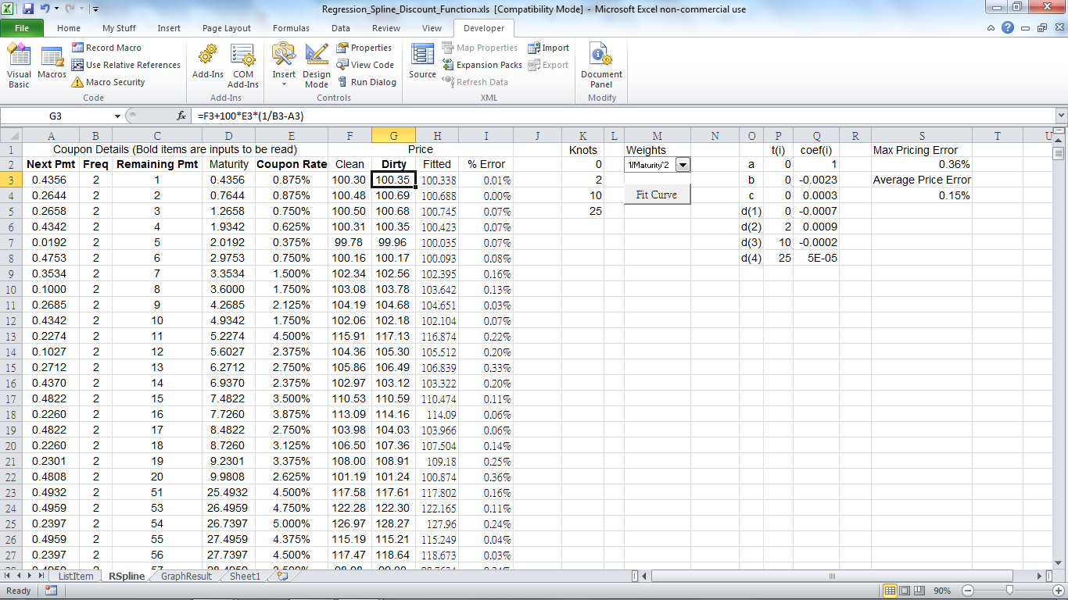

Slide 16
